Slide 1

Houses: The Lost American Dream
Python Project Team Members: Marvina L., Ciin Cing, Dren L.

Slide 2
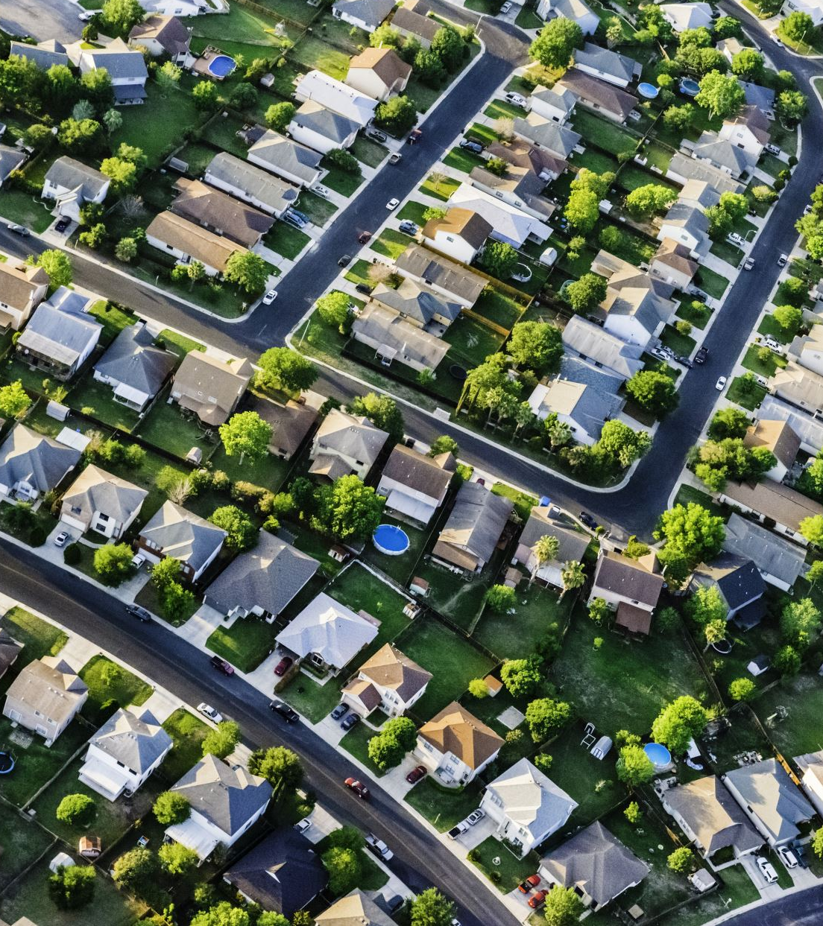
Project Details
Our project focuses on Home Prices and Interest Rates in key states and the US overall with a comparative analysis of the two key components of the hypothesis

Slide 3

Where we got our data
This is our data sources:
https://www.kaggle.com/datasets/federalreserve/interest-rates
https://www.bankrate.com/banking/federal-reserve/history-of-federal-funds-rate/#2001
https://fred.stlouisfed.org/series/MDSTHPI
https://fred.stlouisfed.org/series/TXSTHPI#0
https://fred.stlouisfed.org/series/CTSTHPI
https://fred.stlouisfed.org/series/USSTHPI
https://www.macrotrends.net/2015/fed-funds-rate-historical-chart

Slide 4

hypothesis
We predict the average home price in CT, MD, TX,WA and the US will have a direct correlation with the Federal Funds interest Rate

Slide 5

Data CLEANING, MODIFICATION & merging
After gathering the different sources of data

Slide 6
CLEANING & MERGING of data
After reading in and identifying which datatypes were in the .csv files
A datetime function was used to convert the date datatypes
Re-formatted column names for data uniformity; and to ensure a successful merge
A concat( ) was used to merge six .csv files
A group decision was made to avoid missing values in our data: we would adjust the time frame used in our Project to ensure there would be no missing values

Slide 7
Modification of data
There were a few modifications and updates needed for the sheets including renaming columns, cutting down a few raw csv.files and rearranging dates to appear like the other sheets we had cleaned.
Some of the functions used were pandas DataFrame, averaging monthly numbers for Quarters, .datetime, read.csv, dt.to_period, dt.to_timestamp, and others.
Once these modifications were made, we were able to seamlessly connect our sheets together to be easily turned into graphs and plots that could be read visually.

Slide 8
Plotting the data
In order to align the rows for all the csvs, I needed to create new data frames that have the shortened values
To create a graph with multiple line plots and two y-axes, I created a figure for ax1, set variables for the years, states/fed, and interest rate.
When plotting house prices, it should look like this
To create a second y-axis with a different scale, I used: to combine ax1 and ax2 on the same graph.
Because we are plotting interest rate, it should look like this:
After that, just label, title, add color, and create a legend.
Notes:
For the visualization aspect of this project, we had to first make sure the datasets aligned. Because one csv had 81 rows and the other had 55, we had to cut our timeline down from 2023 to 2016. I did this by creating new data frames for csv that would only count the first 55 rows. As you can see, it was just a simple matter of adding .head and the number of rows you want.
Next we needed to create a graph with multiple line plots and two different y-axes scales. Because housing price was on a different scale than the interest rate, we needed two y-axes. The first axis called ax1 we would plot the the years as x and the housing price of the state as y. This is the code I used and repeated five times.
To create a second ax was just a matter of merging ax1 and ax2 together by doing .twinx(), this will also combine those two on the same graph. Now that we’re plotting interest rate, the code looks similar to the one for ax1.
After that, we just added labels, titles, added color, and created a legend to make it more readable.

Slide 9
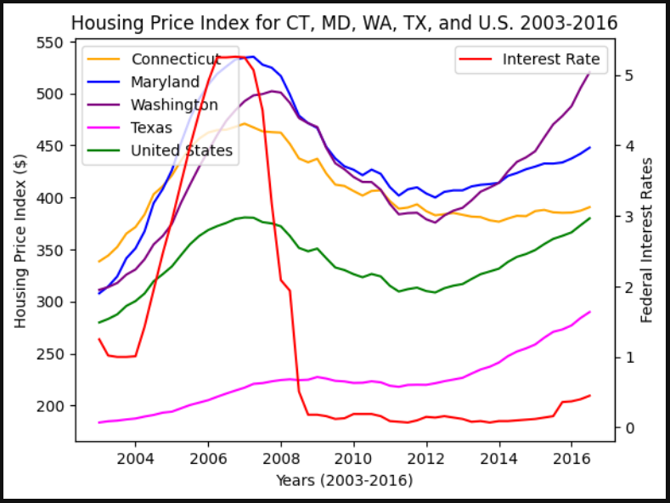
Final graph visualization
In this composite graph, 4 states (CT, MD, TX, WA) were originally aligned with the Federal Interest Rate. Then in 2008, there was a sharp decline in the interest rate, which was caused by the housing crisis of 2008 and a change in the Federal Reserve policy.
Notes:
And here is what the final graph looks like. As you can see, we have our four states (Ct, Md, Tx, Wa), the US, and the federal interest rate in red. In 2008 we noticed a sharp decline in interest rates, which was caused by the housing crisis of 2008 and a change in the Federal Reserve policy.

Slide 10
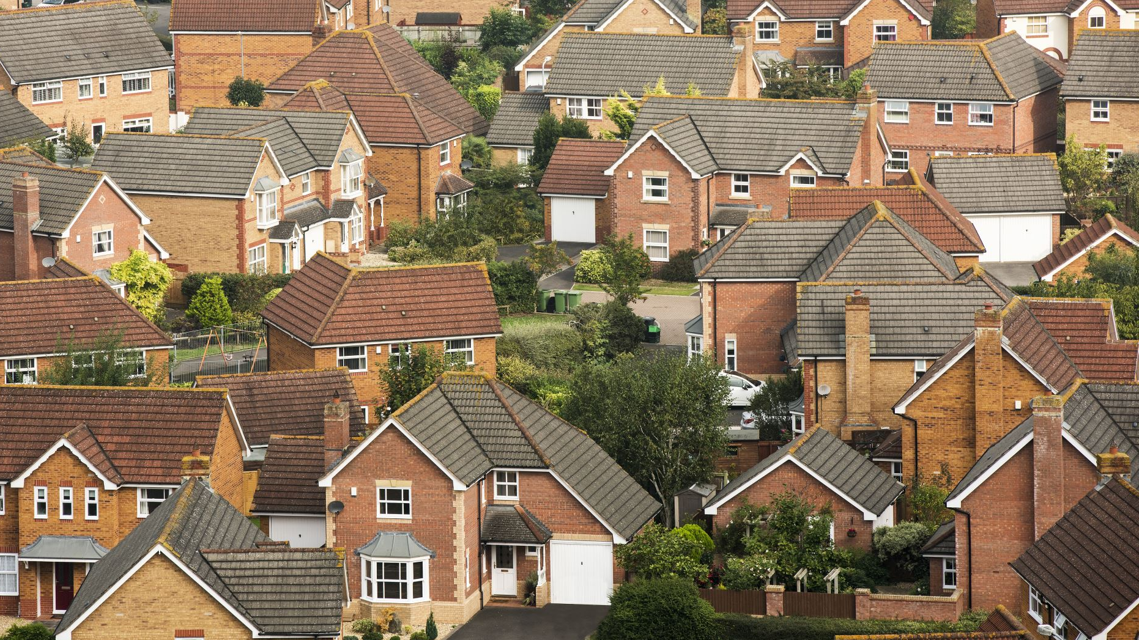
conclusion
Home prices in the markets we analyzed weren’t as significantly impacted by fluctuations in interest rates as initially hypothesized. Home prices decreased at a slower rate, we believe, due to government interventions to stimulate home sales after the housing bubble burst in 2008.
When the interest rate was cut sharply in 2008, due to the housing crisis, house sales decreased while home prices remained unaffected. The lines in our graphs display a sudden decline in the interest rate, while the State HPIs remain steady.
Overall, we believe our hypothesis was proven to be only partially correct. The data revealed that changes in the Federal interest rate did have significant impacts on the markets analyzed initially, but other factors decreased its effect considerably during the years following 2008.

